Slide 1
Advances in Bioinformatics: Multi-Omics
Session 1: Definitions, Modalities, and Analysis Frames Bioinformatics Journal Club

Slide 2
Session Goals
In this session we will:
Define the major omics layers and what each measures
Distinguish parallel vs non-parallel multi-omics
Distinguish integrative vs meta-analytic approaches
Understand sample-focused vs feature-focused analyses
Recognize challenges in multi-omics analysis

Slide 3
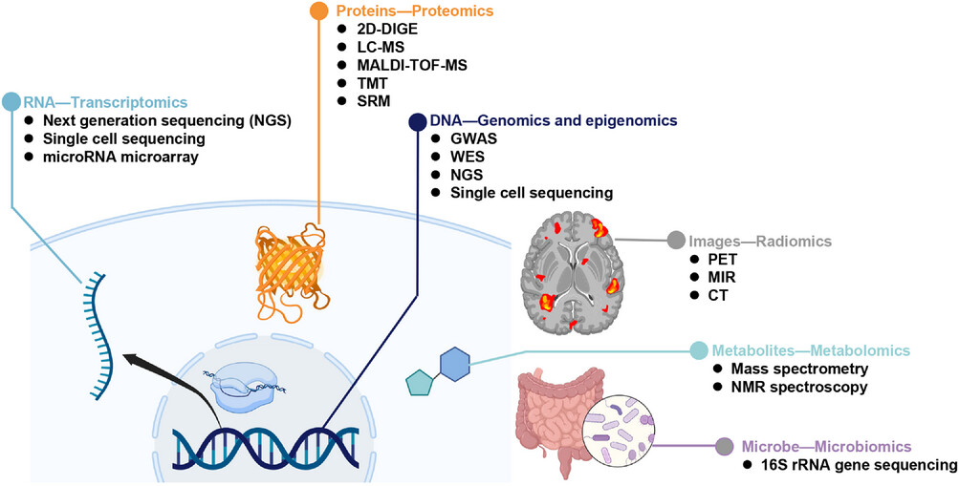
What Is Multi-Omics?
Multi-omics analysis integrates multiple molecular data layers measured on the same biological system to capture complementary aspects of regulation, state, and phenotype.
Key idea: Each omics layer provides a partial and complementary view of biology.
Conceptual overview of multi-omics data types

Slide 4
Why Multi-Omics Exists
Notes:
Single-omic analyses answer limited questions: What mutations exist? Which genes are expressed? Multi-omics enables deeper questions: Which mutations are functional? How regulation, expression, and phenotype connect. Why similar tumors behave differently.

Slide 5
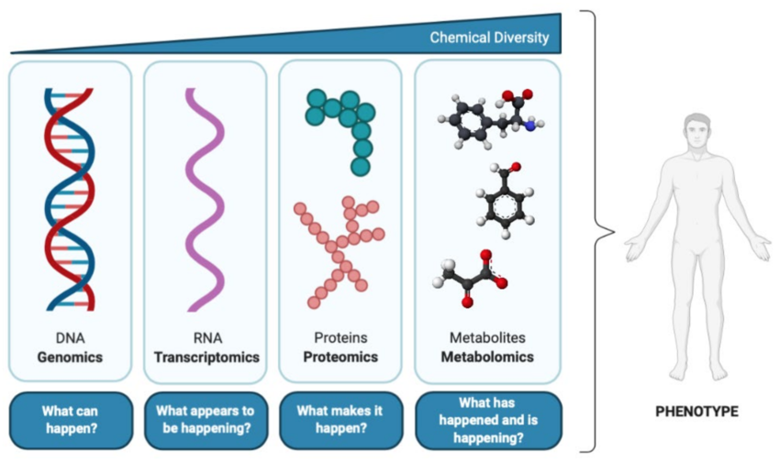
The Central Dogma of Biology
Genome → Epigenome → Transcriptome → Proteome → Metabolome
Information flow is not strictly linear
Each layer captures a different biological abstraction
Multi-layer information flow from genome to metabolome
Notes:
Integration attempts to recover relationships between layers. Classic reference: Hasin et al., Genome Biology 2017.

Slide 6
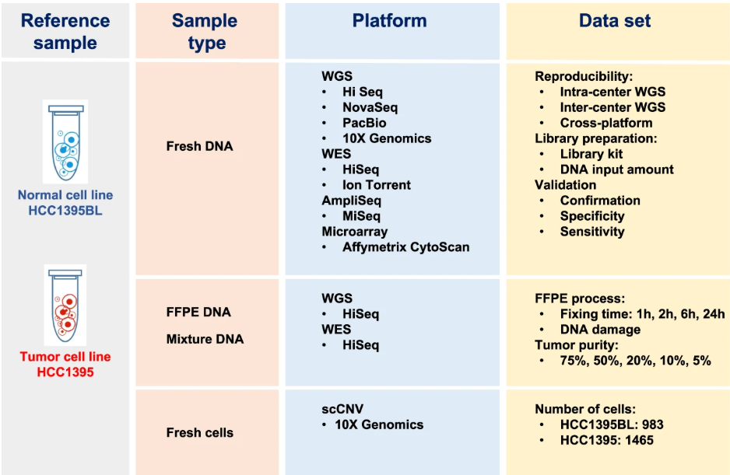
Genomics
Definition: DNA sequence variation including germline and somatic mutations, copy number alterations, and structural variants
Common technologies: - Whole-genome sequencing (WGS) - Whole-exome sequencing (WES) - Targeted gene panels
Genomics technology comparison

Slide 7
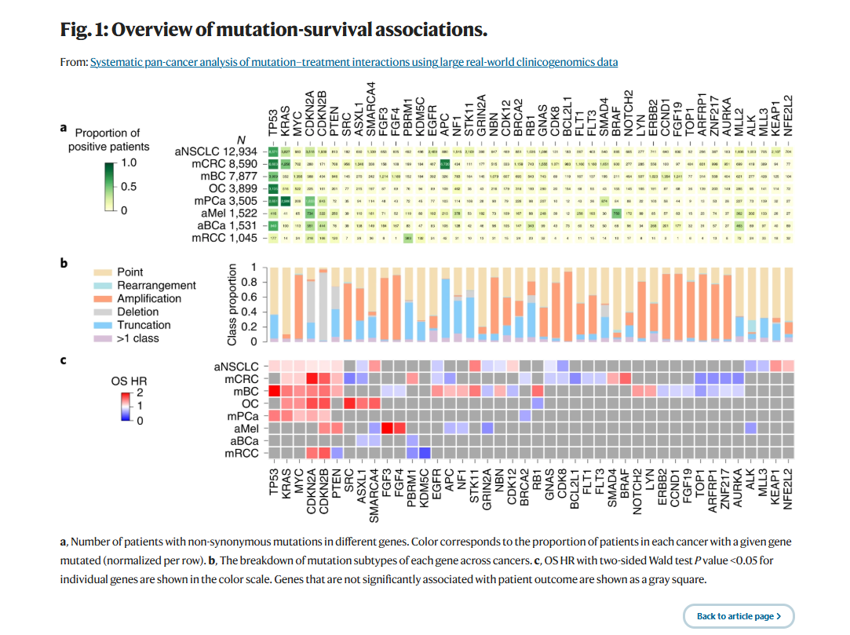
Genomics: Why It Matters
What genomics tells us: - Cancer drivers and susceptibility - Clonal structure and evolution - What could happen biologically
TCGA Pan-Cancer mutation landscape showing recurrent drivers
Notes:
Concrete example: Pan-cancer analysis showing recurrent driver mutations across cancer types, their mutation mechanisms (point mutations, amplifications, etc.), and prognostic associations. Demonstrates how genomics identifies both driver genes and clinically relevant alterations. Key limitation: Genomics does not measure activity or regulation—mutation presence doesn’t tell us if the pathway is active or how it’s being regulated.

Slide 8
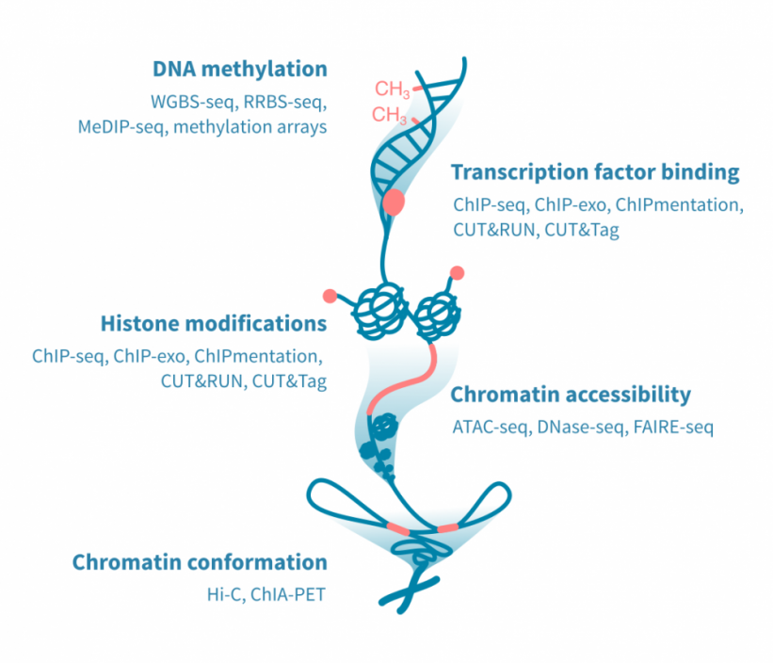
Epigenomics
Definition: Chromatin state and DNA modifications that regulate gene accessibility without altering DNA sequence
Common technologies: - ATAC-seq (chromatin accessibility) - ChIP-seq / CUT&RUN (TFs, histone marks) - DNA methylation sequencing (WGBS, RRBS)
Epigenomics assay types and readouts

Slide 9
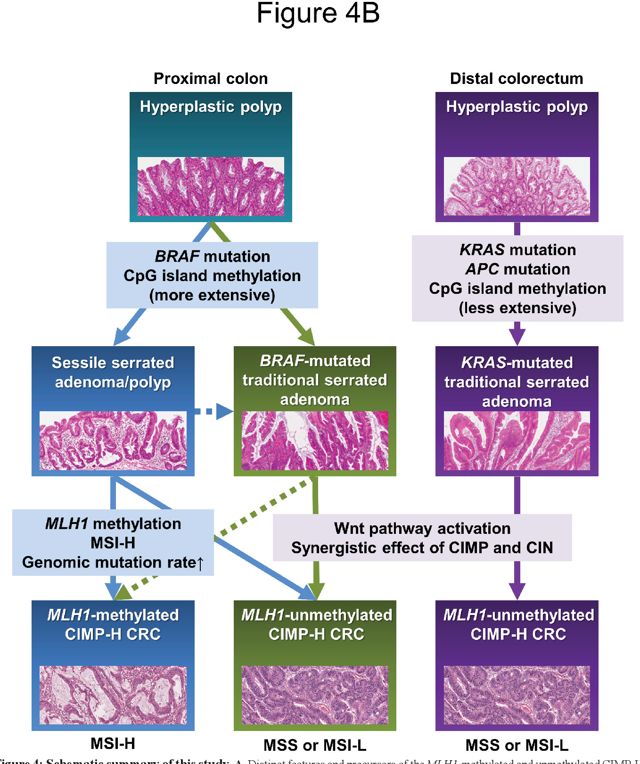
Epigenomics: Why It Matters
What epigenomics tells us: - Regulatory potential - Cell identity and lineage memory - Mechanisms of transcriptional control
CpG island methylator phenotype in colorectal cancer
Notes:
Concrete example: CpG island methylator phenotype (CIMP) in colorectal cancer shows how epigenetic silencing drives tumorigenesis independent of mutation.

Slide 10
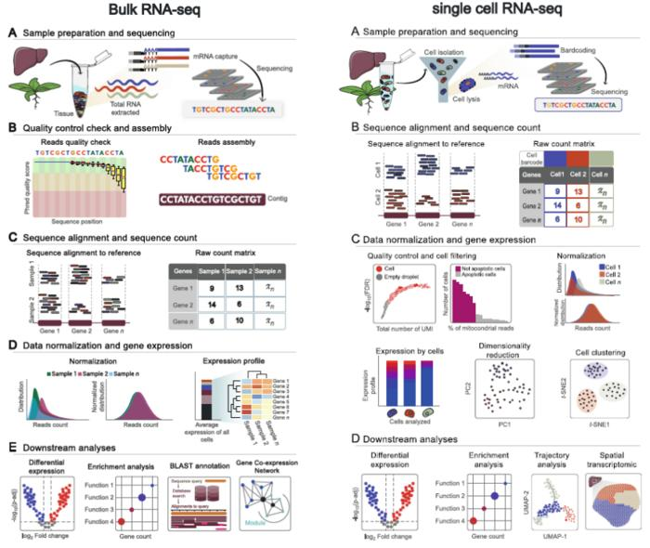
Transcriptomics
Definition: RNA abundance capturing active gene expression programs
Common technologies: - Bulk RNA-seq - Single-cell RNA-seq - Spatial transcriptomics
Transcriptomics technology comparison

Slide 11
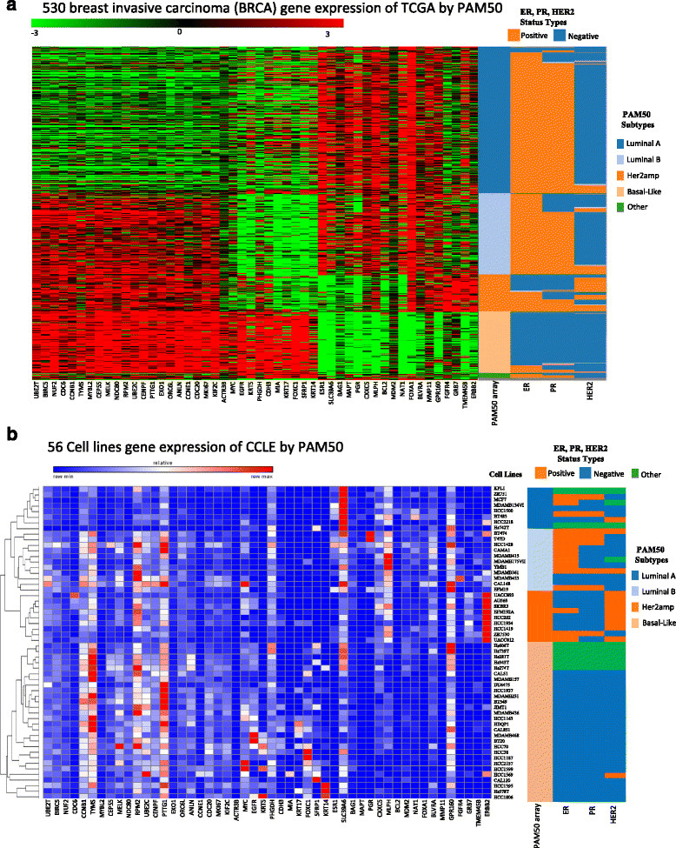
Transcriptomics: Why It Matters
What transcriptomics tells us: - Pathway activation - Cell states and populations - Tumor microenvironment composition
PAM50 breast cancer subtypes based on expression
Notes:
Concrete example: Expression-based cancer subtypes like PAM50 breast cancer classification. Caveat: RNA abundance ≠ protein abundance ≠ activity.

Slide 12
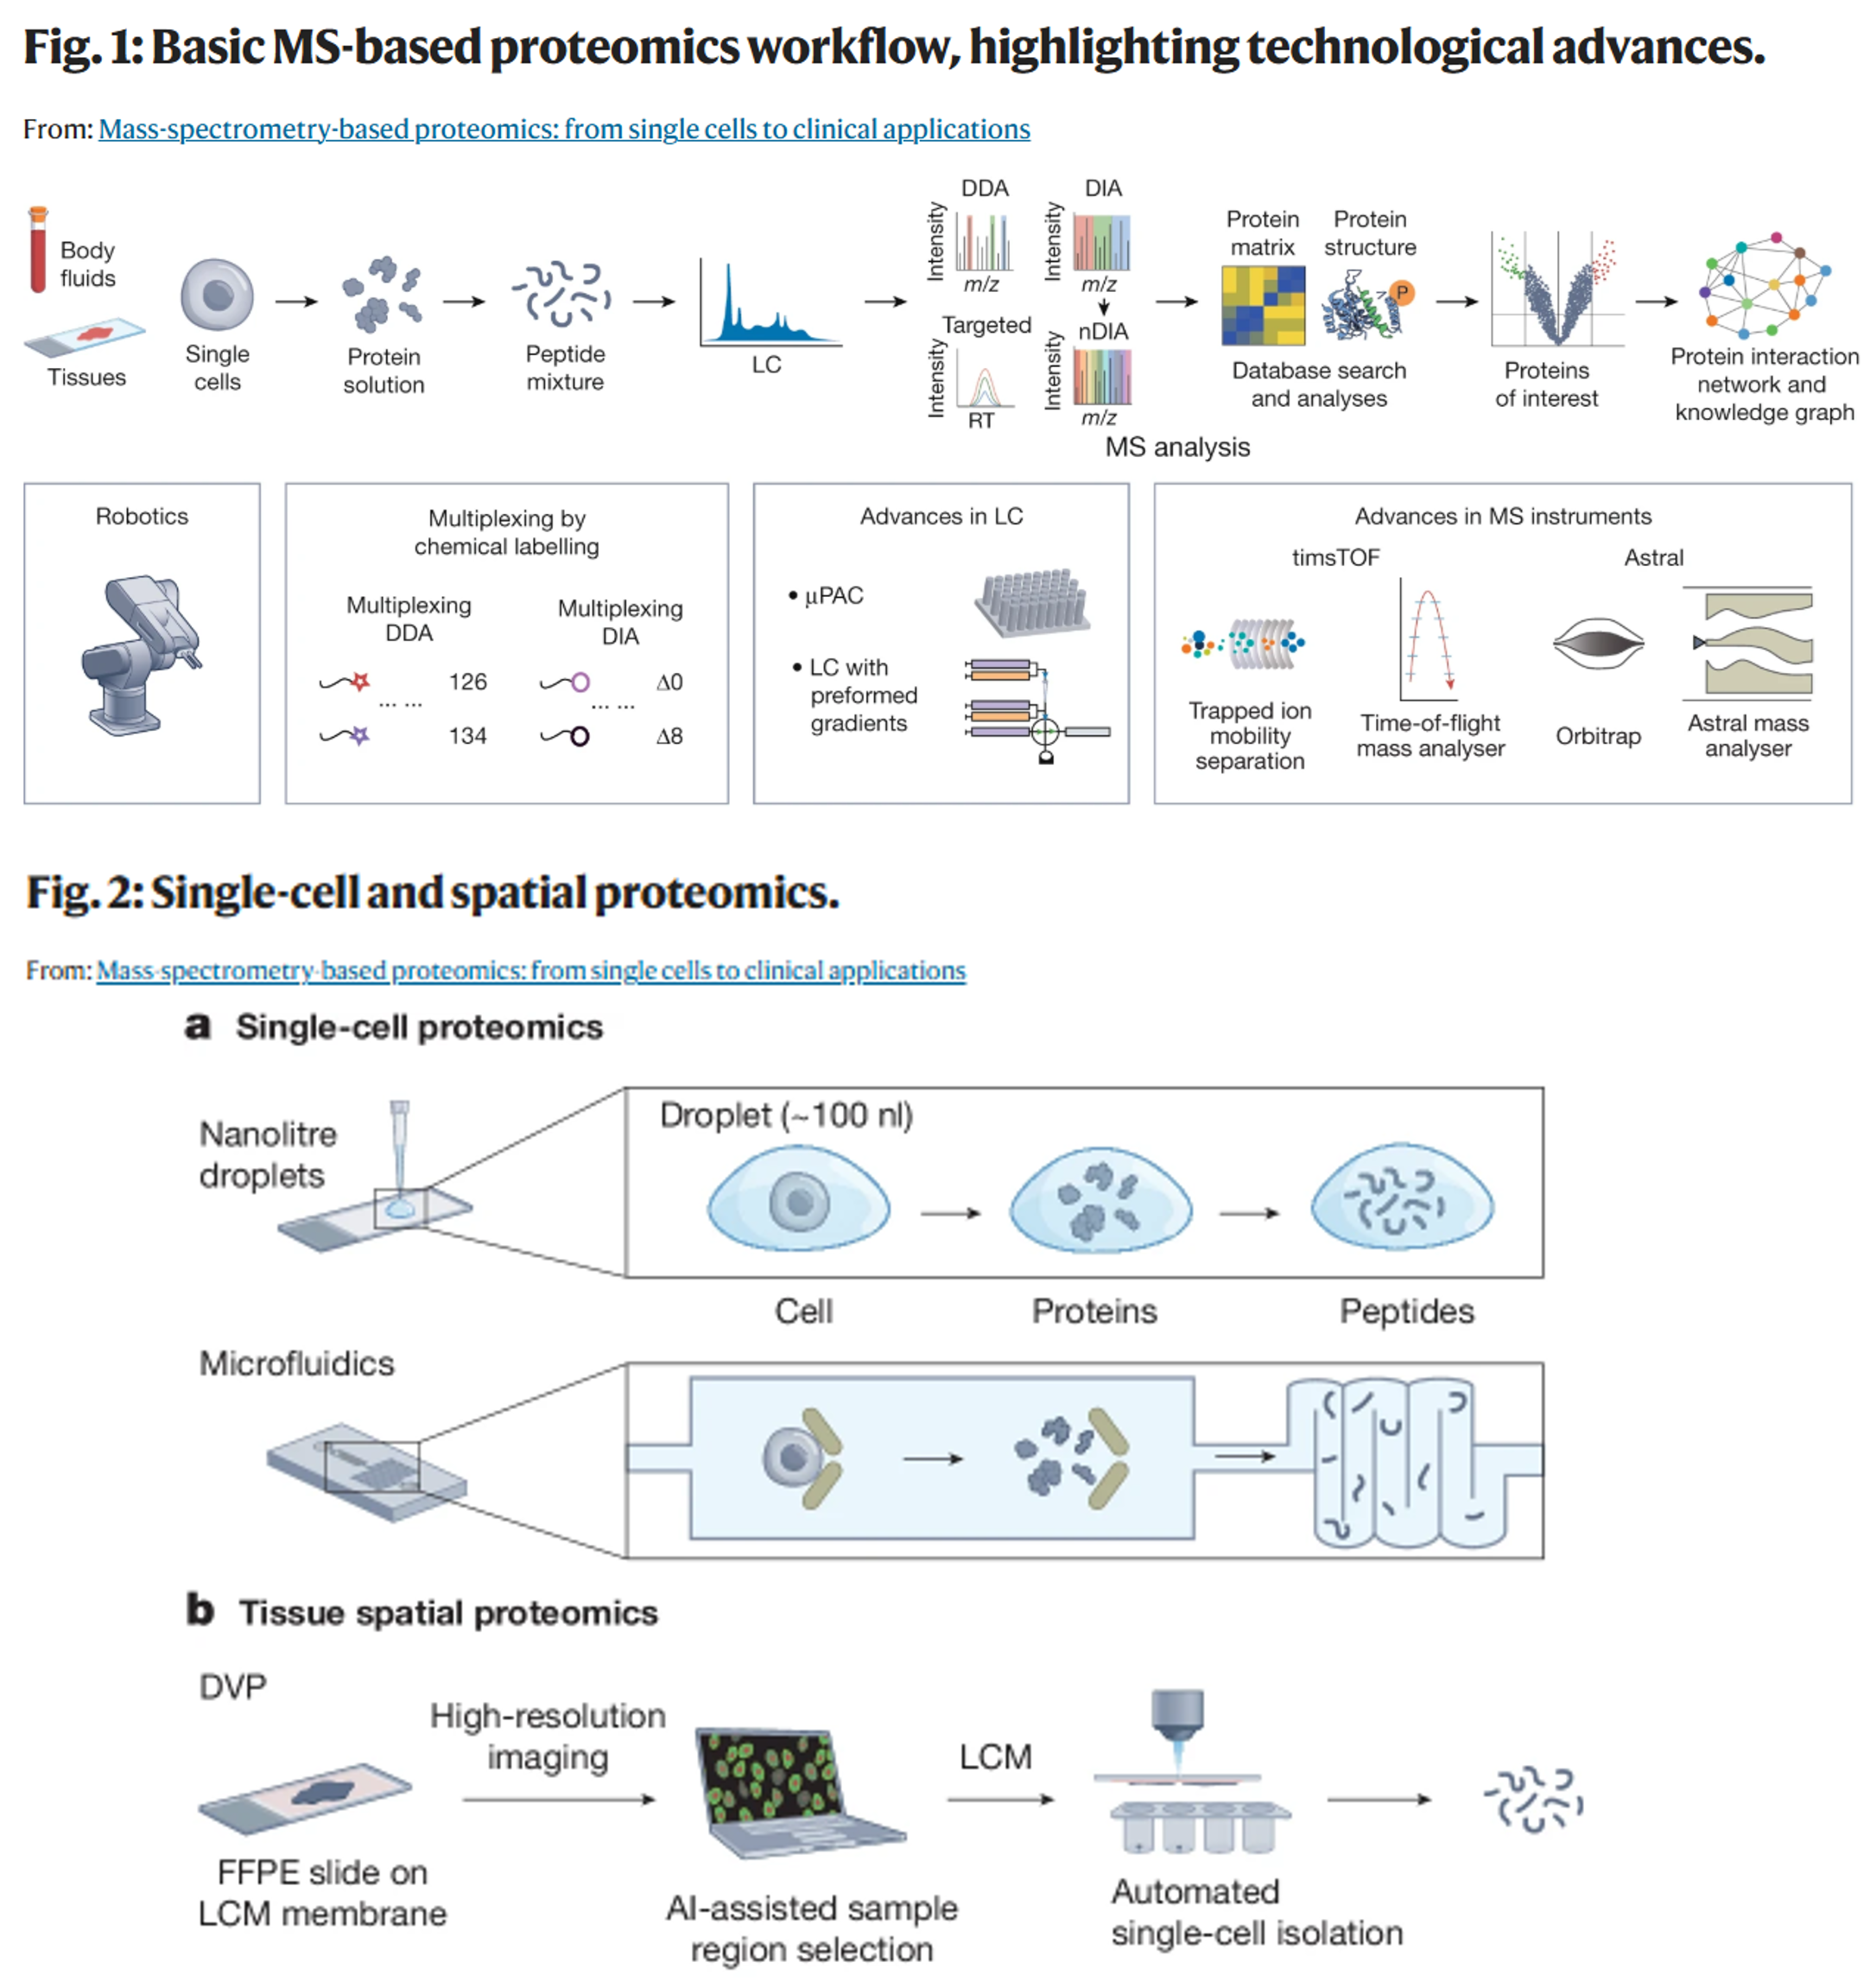
Proteomics
Definition: Protein abundance, modifications, and interactions—the functional machinery of the cell
Common technologies: - Mass spectrometry–based proteomics - Antibody-based platforms (RPPA, CyTOF)
Proteomics workflow and platforms

Slide 13
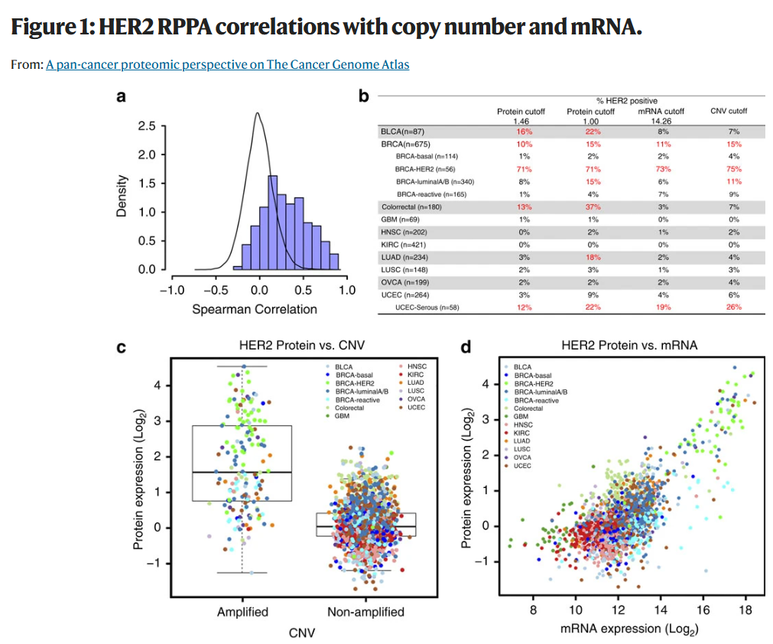
Proteomics: Why It Matters
What proteomics tells us: - Functional protein levels for clinical decisions - Discordance between genomic/transcriptomic and protein layers - Post-transcriptional regulation
HER2 assessment across genomic, transcriptomic, and proteomic layers
Notes:
Concrete example: HER2 classification varies by layer—samples HER2+ by protein may be negative by RNA or CNV. RNA-protein correlation is only 0.53. For anti-HER2 therapy decisions, protein measurement is essential. This discordance motivates multi-omics integration to capture regulation from DNA → RNA → protein.

Slide 14
Metabolomics
Definition: Small molecules reflecting biochemical activity and metabolic flux
Common technologies: - LC-MS / GC-MS - Targeted vs untargeted metabolomics
Metabolomics workflow

Slide 15
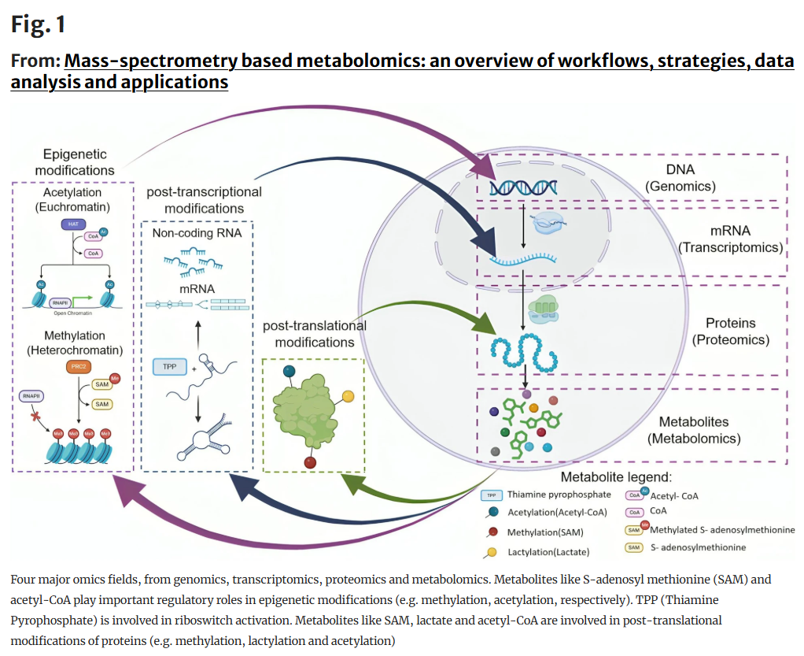
Metabolomics: Why It Matters
What metabolomics tells us: - Metabolic regulation of epigenetics and protein function - Phenotype-proximal biology - Metabolic reprogramming in disease
Metabolites as regulatory molecules connecting omics layers
Notes:
Concrete example: Metabolites like SAM (S-adenosylmethionine) drive DNA/histone methylation, while acetyl-CoA enables histone acetylation. Lactate affects post-translational modifications. Metabolomics reveals how metabolism directly regulates gene expression and protein function, connecting metabolic state to epigenetic and proteomic layers—motivating multi-omics integration.

Slide 16
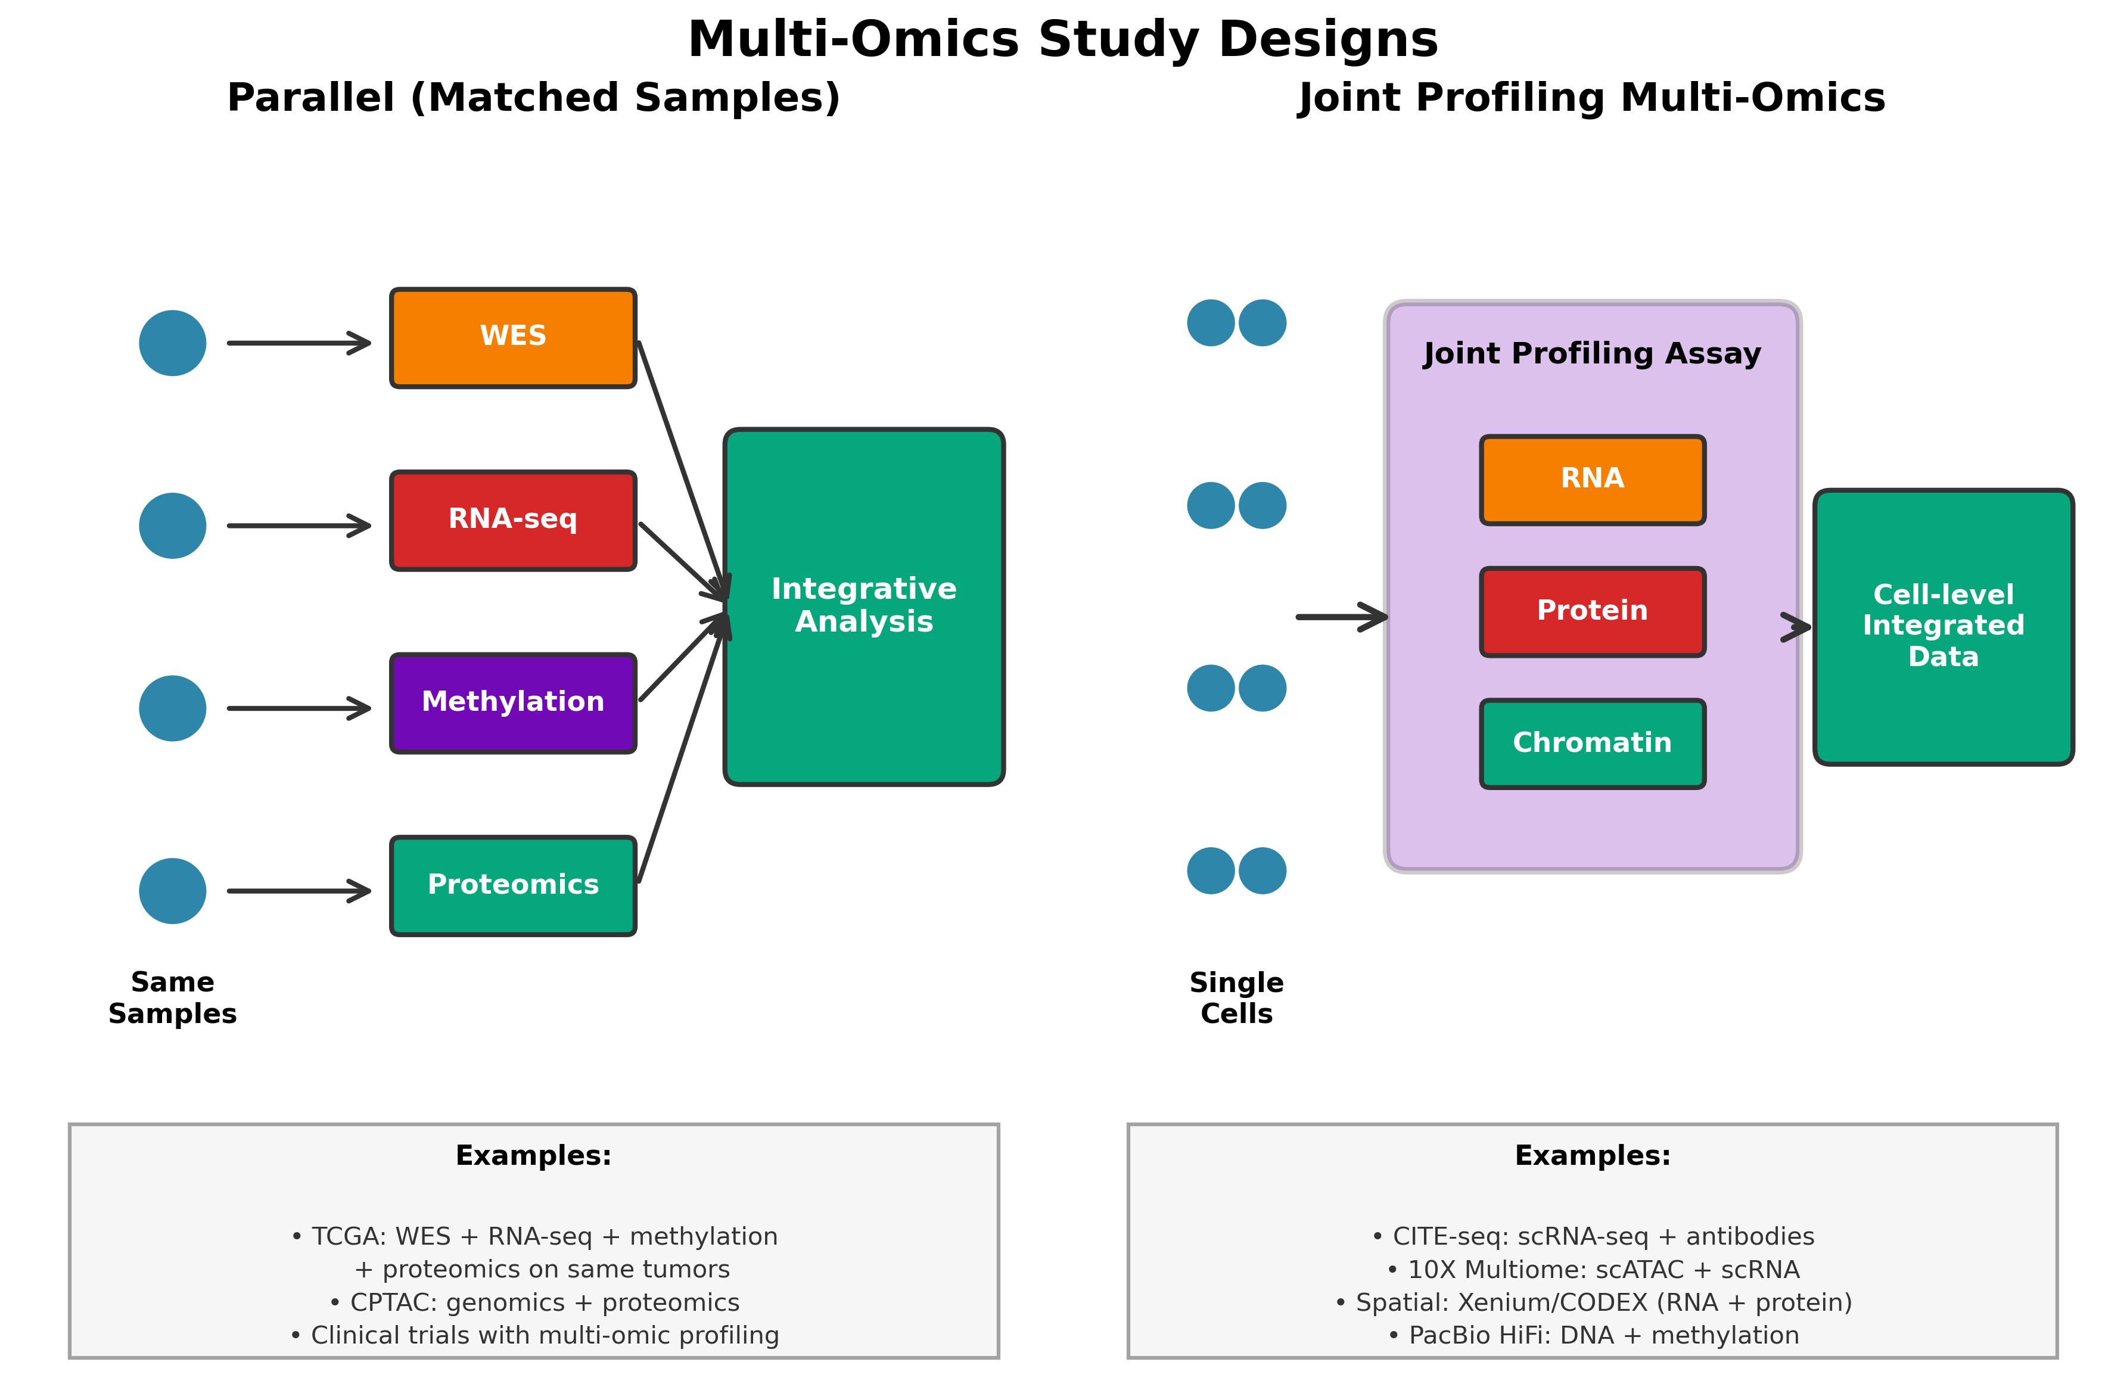
Parallel vs Joint Profiling Multi-Omics
Parallel (matched samples): Multiple omics on the same samples → direct integration
Joint Profiling: Multiple omics from the same cells/tissue → integrated analysis tools
Schematic showing two multi-omics paradigms

Slide 17
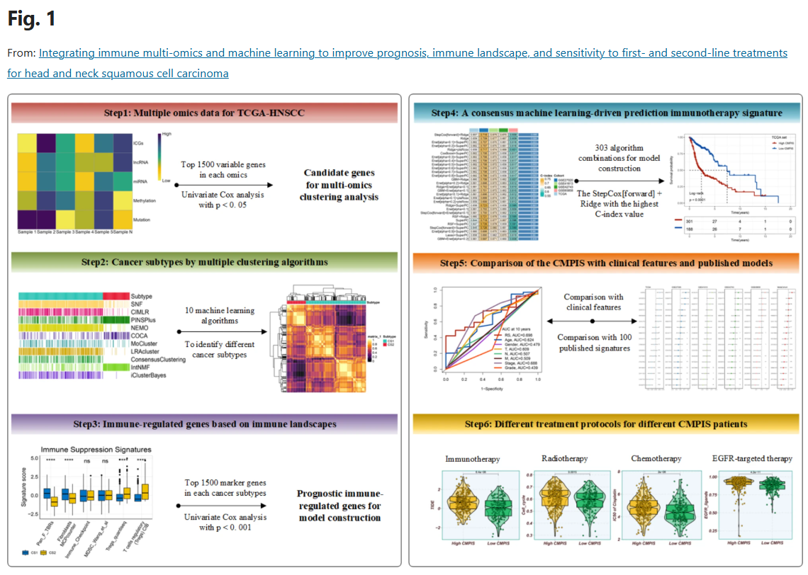
Parallel Multi-Omics: Study Example
TCGA study showing mutation-expression relationships
Notes:
Example: TCGA studies showing how somatic mutations correlate with expression subtypes, or how methylation patterns predict clinical outcomes. Main finding should demonstrate cross-layer relationships that wouldn’t be visible in single-omic analysis.

Slide 18
Single-Cell Multi-Omics Technologies
Omics Combination | Methods
Genome + Transcriptome | G&T-seq, SCTG, DR-seq, SIDR-seq, TARGET-seq, sci-L3-RNA/DNA, DNTR-seq, scONE-seq
Epigenome + Transcriptome | scMT-seq, scCAT-seq, sci-CAR, SNARE-seq, scDam&T-seq, Paired-seq, SHARE-seq, ASTAR-seq, SNARE-seq2, scChaRM-seq, Smart-RRBS, scNOMeRe-seq, Paired-Tag, scPCOR-seq, uCoTargetX
Transcriptome + Proteome | REAP-seq, CITE-seq, RAID, inCITE-seq, SPARC, CaRPool-seq, InTraSeq
Transcriptome + CRISPR | Perturb-seq, CRISP-seq, CROP-seq
Epigenome + Proteome | ICICLE-seq, ASAP-seq, PHAGE-ATAC, scCUT&Tag-pro
Epigenome + CRISPR | Perturb-ATAC, CRISPR-sciATAC, Spear-ATAC
Transcriptome + Epigenome + Proteome | TEA-seq, DOGMA-seq, NEAT-seq, CellOracle
Genome + Epigenome + Transcriptome | scTrio-seq, snmCAT-seq
Transcriptome + Proteome + CRISPR | ECCITE-seq
Transcriptome + Metabolome | scMeT-seq
Multi-modal flexible | UDA-seq

Slide 19
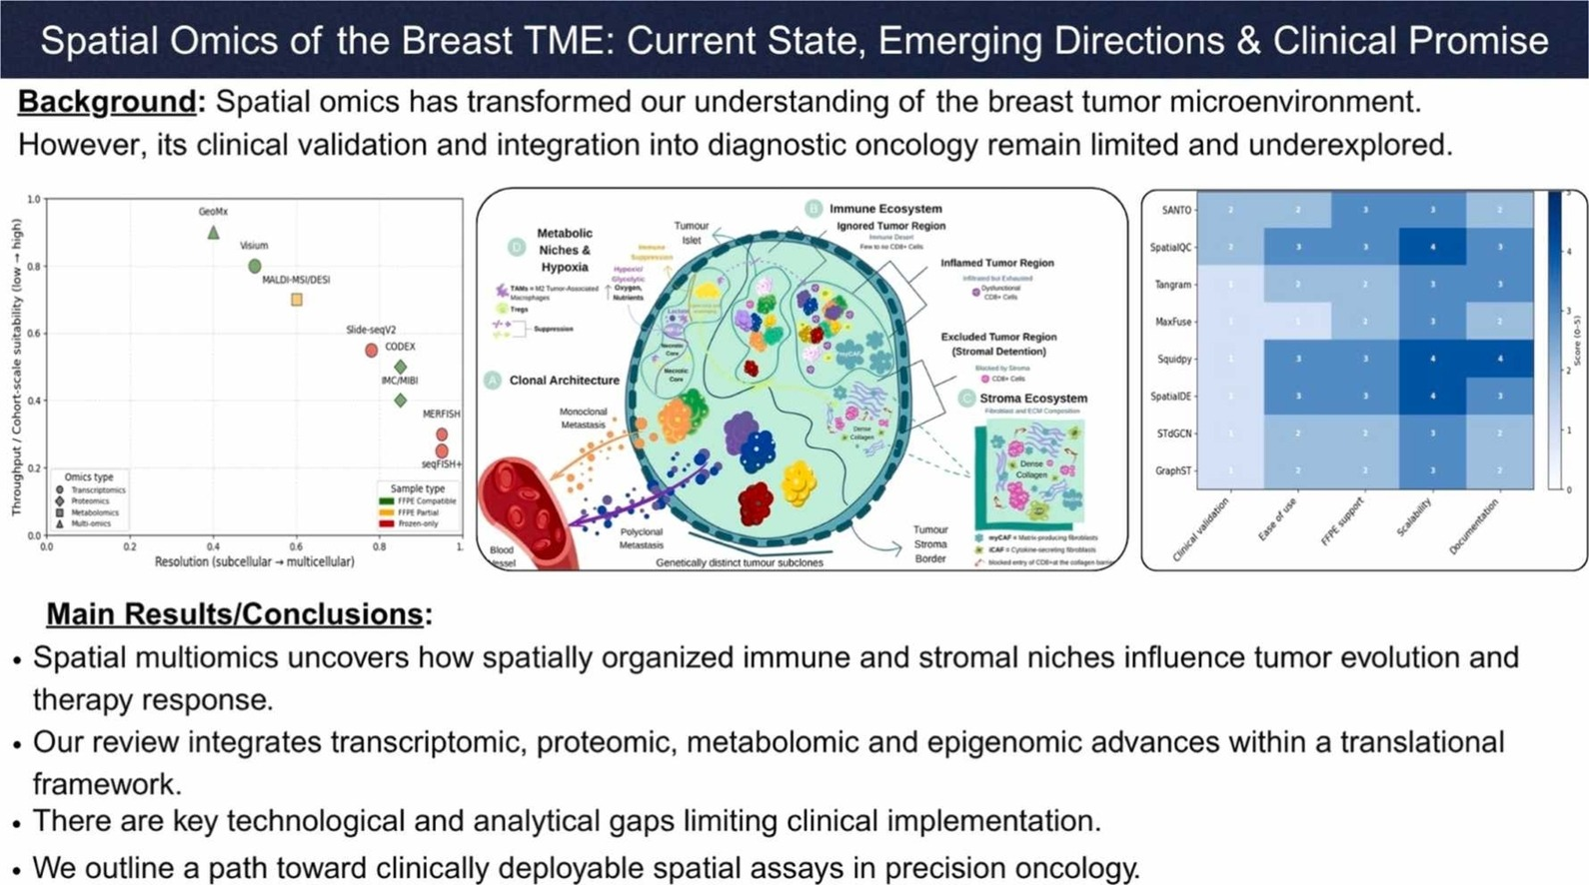
Spatial Omics of the Breast Tumor Microenvironment
Results from joint profiling study showing cell-level integration
Notes:
Example study using multi-modal technology to reveal cell-type-specific regulation, spatial organization, or disease mechanisms that require simultaneous measurement of multiple layers. Main finding should highlight insights only possible with multi-modal data.

Slide 20
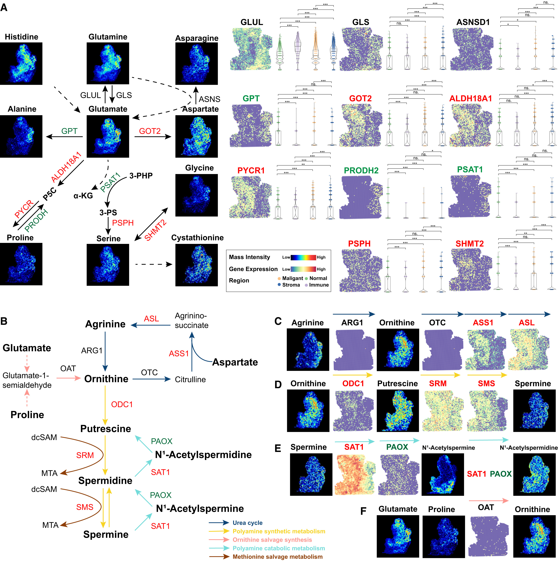
Integrated spatial omics of metabolic reprogramming and the tumor microenvironment in pancreatic cancer
Results from joint profiling study showing cell-level integration
Notes:
Example study using multi-modal technology to reveal cell-type-specific regulation, spatial organization, or disease mechanisms that require simultaneous measurement of multiple layers. Main finding should highlight insights only possible with multi-modal data.

Slide 21
Integrative Analysis vs Meta-Analysis
Meta-analysis - Combine results after independent analyses - Example: overlap of enriched pathways
Integrative analysis - Joint modeling across omics layers - Example: latent factor models (e.g., MOFA-like frameworks)

Slide 22
Why This Distinction Matters
Integration ≠ stacking plots
Different assumptions
Different failure modes
Different interpretability

Slide 23
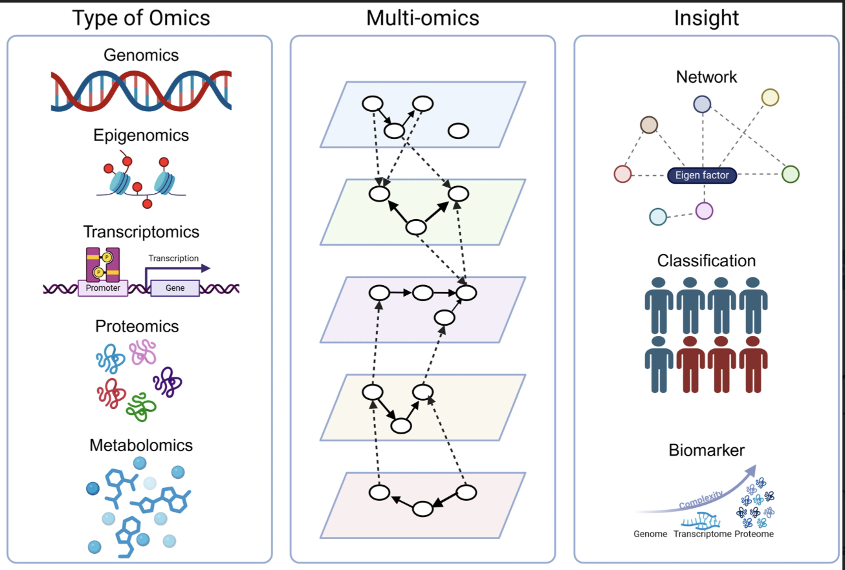
Multi-Omics Integration Approaches
Multi-omics integration strategies for different analytical goals

Slide 24
Sample-Centric - Goal: Cluster/classify samples - Output: Patient subtypes, groups - Example: Cancer subtyping - Unit: Samples
Feature-Centric - Goal: Infer mechanisms - Output: Networks, pathways - Example: Regulatory networks - Unit: Genes, proteins
Notes:
Figure shows multi-omics integration (middle panel) can yield different insights (right panel) depending on analytical approach. Sample-centric analysis (bottom right: Classification) integrates across omics layers to group samples into subtypes based on molecular similarity - shown as blue vs. brown patient groups. Feature-centric analysis (top right: Network) connects molecular features across layers to infer biological mechanisms - shown as network with eigen factor connecting different molecular entities. The middle panel illustrates how each omics layer contains within-layer relationships (nodes and edges within each plane) and cross-layer relationships (dashed lines between planes) that can be leveraged for either approach.

Slide 25
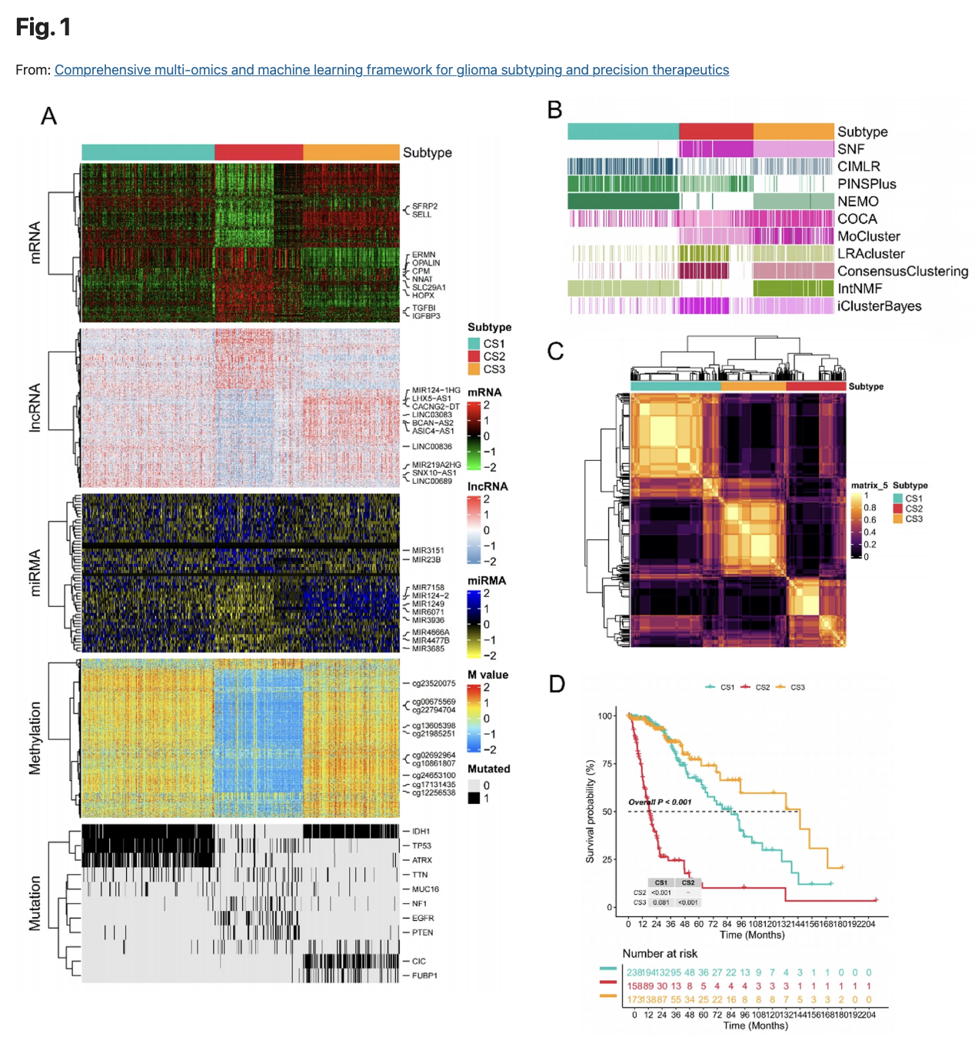
Sample-Centric Example: Cancer Subtyping
Integration approach: - Genomics + transcriptomics + proteomics - Clustering/classification across samples - Molecular subtypes with clinical relevance
Question asked: Which molecular subtypes exist and how do they relate to outcomes?
Multi-omics cancer subtyping and clinical outcomes
Notes:
Sample-centric analysis integrates multi-omics data across samples to identify biologically and clinically meaningful subtypes. Figure should show: (1) Multi-omics clustering (UMAP, heatmap, or consensus clustering), (2) Molecular subtype assignments, (3) Clinical associations (survival curves, treatment response). Example: TCGA pan-cancer iCluster analysis revealing molecular subtypes that cross tissue boundaries, or multi-omics classification of breast cancer into actionable subtypes beyond PAM50.

Slide 26
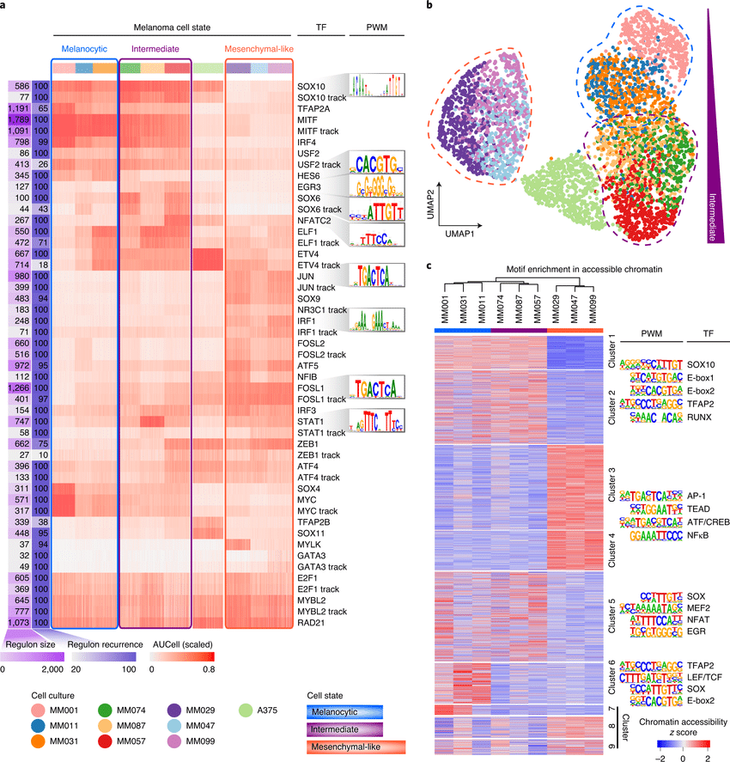
Feature-Centric Example: Regulatory Networks
Integration layers: - SCENIC infers TF regulons from scRNA-seq - TF motifs predict regulatory targets - ATAC-seq validates chromatin accessibility
Question asked: Which TFs regulate melanoma cell state transitions?
SCENIC regulatory network inference in melanoma
Notes:
True integration example using SCENIC to infer gene regulatory networks. Panel a: Regulon activity heatmap showing TF programs across melanoma cell states (Melanocytic, Intermediate, Mesenchymal), with DNA-binding motifs for key TFs. Panel b: UMAP based on regulon activities separates intermediate state, showing regulatory programs distinguish cell states. Panel c: ATAC-seq chromatin accessibility validates that predicted TFs have accessible binding sites in corresponding states. This demonstrates feature-centric analysis where multi-omics integration reveals regulatory mechanisms controlling phenotype switching, impossible from RNA or chromatin alone.

Slide 27
Challenges in Multi-omics Analysis
So far, we’ve focused on: - What different omics layers measure - How multi-omics analyses are performed
Next, we’ll shift to: - Why multi-omics analyses are challenging in practice

Slide 28
Heterogeneity Across Omics Layers
Common observations: - RNA–protein discordance - Open chromatin without expression - Metabolic changes without transcriptional shifts
Important framing > Disagreement across omics is often the signal, not the noise.

Slide 29
Missing Data in Multi-Omics
Types of missingness - Missing by design (not assayed) - Missing not at random (low abundance) - Platform-specific dropout

Slide 30
Why Missingness Matters
Breaks naïve integration methods
Forces modeling assumptions
Limits interpretability

Slide 31
Key Takeaways
Each omics layer answers a different question
Multi-omics is a framework, not a checklist
Integration requires careful design
Complexity is the cost of biological realism

Slide 32
Next Session
Session 2:

